Slide 1
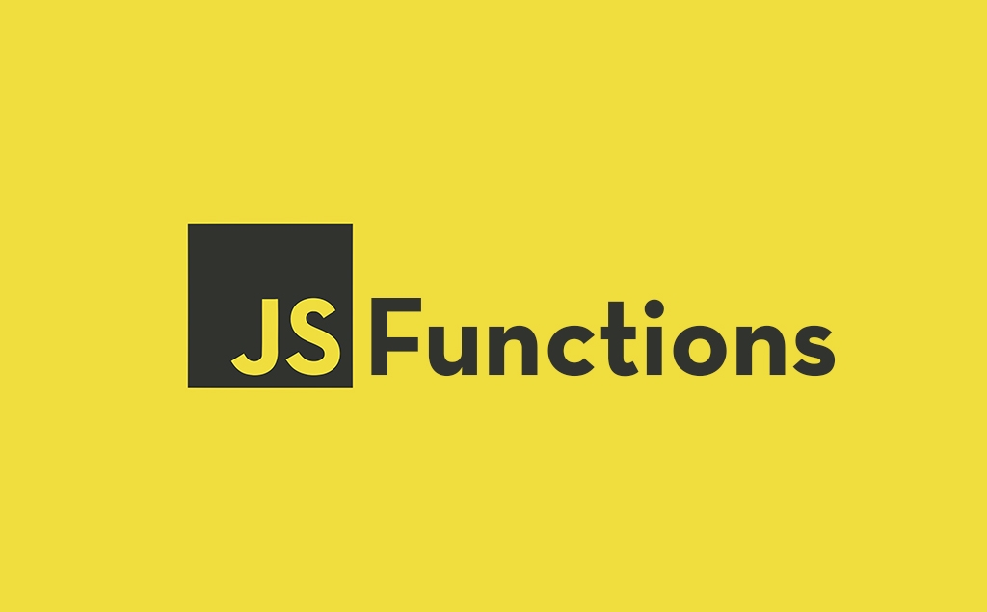

Slide 2
What we Cover Today:
01
02
03
04
05
Function
Parameters and Arguments
Default Parameters
Reset Parameters
Exercise

Slide 3
Function
Functions are fundamental building blocks in all programming.
Functions are reusable block of code designed to perform a particular task
Why Use Functions
With functions you can reuse code
You can write code that can be used many times.
You can use the same code with different arguments, to produce different results.

Slide 4
Function
There are two types of Function in JavaScript:
Built it Function
User Defined Function
Built it Function
A built-in function in JavaScript means:
a function that is already made by JavaScript.
you don’t need to write it yourself.
you can use it directly.
Example: alert(), parseInt(), console.log(), etc

Slide 5
Function
User defined Function
A user-defined function is a function that you create yourself (not built-in).
You make it when you want to do a task many times in your code.
Syntax Normal Function
function functionName() {
// code
}
Does not take any input
Runs the same code every time

Slide 6
Function
Example
function sayHello() {
console.log(“Hello, World!”);
}
sayHello();

Slide 7
Function
Syntax Function with Parameters
function functionName(parameter1, parameter2, …) {
// code
}
Takes input (parameters)
Can give different results depending on input

Slide 8
Function
Example
function greet(name) {
console.log("Hello " + name);
}
greet("Ahmed"); // Output: Hello Ahmed
greet(“Asma"); // Output: Hello Asma

Slide 9
Function
Parameters vs Arguments
Parameters are the names listed in the function definition.
Parameters are the names of the values that will be passed.
Arguments are the values passed to the function when it is invoked or called.
Arguments are the values received by the function.

Slide 10
Function
Non Return Function
Does not use return.
Only performs an action (like printing, showing alert).
You cannot store its result in a variable.
Example:
function sayHello(name) {
console.log("Hello " + name);
}
sayHello("Ahmed"); // Output: Hello Ahmed
let result = sayHello("Ali");
console.log(result); // Output: undefined (because no return)

Slide 11
Function
Default Parameters
Normally, when you make a function, you must pass values (arguments).
If you don’t give a value, the parameter will be undefined.
Default parameters let you give a value in advance, so if the user doesn’t provide one, JavaScript will use the default.
Syntax
function functionName(param1 = defaultValue1, param2 = defaultValue2) {
// code here
}

Slide 12
Function
Default Parameters
Example 1: without Default
function greet(name) {
console.log("Hello " + name);
}
greet("Ahmed"); // Output: Hello Ahmed
greet(); // Output: Hello undefined ❌

Slide 13
Function
Default Parameters
Example 2: with Default Parameter
function greet(name = "Guest") {
console.log("Hello " + name);
}
greet("Amina"); // Output: Hello Amina
greet(); // Output: Hello Guest ✅

Slide 14
Function
Rest Parameters
Sometimes you don’t know how many arguments (values) a function will get.
Rest parameters allow you to collect all extra arguments into an array.
You write it with three dots ... before the parameter name.
Syntax
function functionName(...restParameter) {
// restParameter is an array
}

Slide 15
Function
Rest Parameters
Example 1: Normal parameters
function add(a, b) {
return a + b;
}
console.log(add(2, 3)); // Output: 5
console.log(add(2, 3, 4)); // Extra value ignored → Output: 5

Slide 16
Function
Rest Parameters
Example 2: Using Rest Parameters
function addAll(...numbers) {
let sum = 0;
for (let i = 0; i < numbers.length; i++) {
sum += numbers[i];
}
return sum;
}
console.log(addAll(5, 10, 15)); // 30

